Slide 1


Disastrous Start
Università Degli Studi Di Salerno
DIPARTIMENTO DI INGEGNERIA DELL'INFORMAZIONE ED ELETTRICA E MATEMATICA APPLICATA
Machine Learning – Project Work
Tennis Table Tournament
Professors:
Foggia Pasquale
Gragnaniello Diego
Vento Mario
Team Members:
Ciaravola Giosuè
Conato Christian
Del Gaudio Nunzio
Garofalo Mariachiara

Slide 2
Università Degli Studi Di Salerno
Disastrous Continuum
DIPARTIMENTO DI INGEGNERIA DELL'INFORMAZIONE ED ELETTRICA E MATEMATICA APPLICATA
Disastrous Start
Reinforcement Learning: everything in input to compute all the actions
(2 hidden layers with 400 neurons)
× Learn nothing after a night of training
× Perhaps a much larger architecture is needed, which would require more time for learning
✅ Divide the tasks, reducing the inputs given to the network and the outputs it needs to compute
✅ If there is an algorithmic way to do something perfectly, do it
Machine Learning – Project Work
Professors:
Foggia Pasquale
Gragnaniello Diego
Vento Mario
Reinforcement Learning for the Arm: with algorithmic cart and locked paddle with
the 3 pitch joints, ball and paddle position in input, to compute the 3 pitch joints values
(2 hidden layers with 400 neurons)
Team Members:
Ciaravola Giosuè
Conato Christian
Del Gaudio Nunzio
Garofalo Mariachiara
Tennis Table Tournament
× Locked in a strange pose in a corner after a night of training

Slide 3

Disastrous Start
Supervised: Arm
Disastrous Continuum
Reinforcement Learning for the Arm: with algorithmic cart and locked paddle with
the 3 pitch joints, ball and paddle position in input, to compute the 3 pitch joints values
(2 hidden layers with 400 neurons)
× Locked in a strange pose in a corner after a night of training
× Positive reward for staying still
✅ If you can, do Supervised Learning
Machine Learning – Project Work
Reinforcement Learning: everything in input to compute all the actions
(2 hidden layers with 400 neurons)
× Learn nothing after a night of training
× Perhaps a much larger architecture is needed, which would require more time for learning
✅ Divide the tasks, reducing the inputs given to the network and the outputs it needs to compute
✅ If there is an algorithmic way to do something perfectly, do it

Slide 4
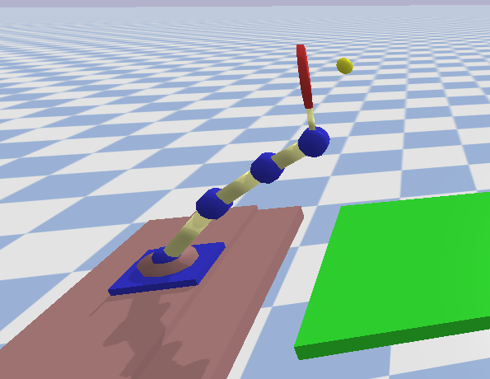
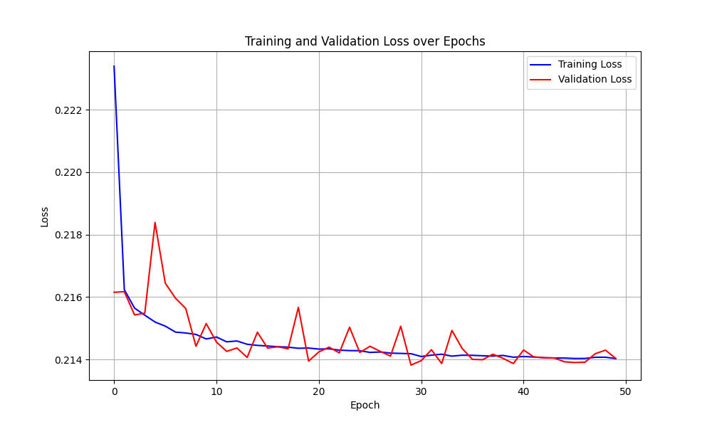
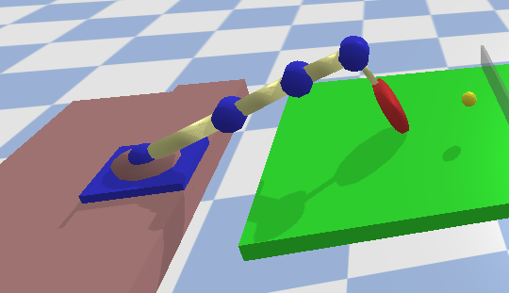
Disastrous Continuum
Reinforcement: Paddles
Supervised: Arm
Machine Learning – Project Work

Slide 5
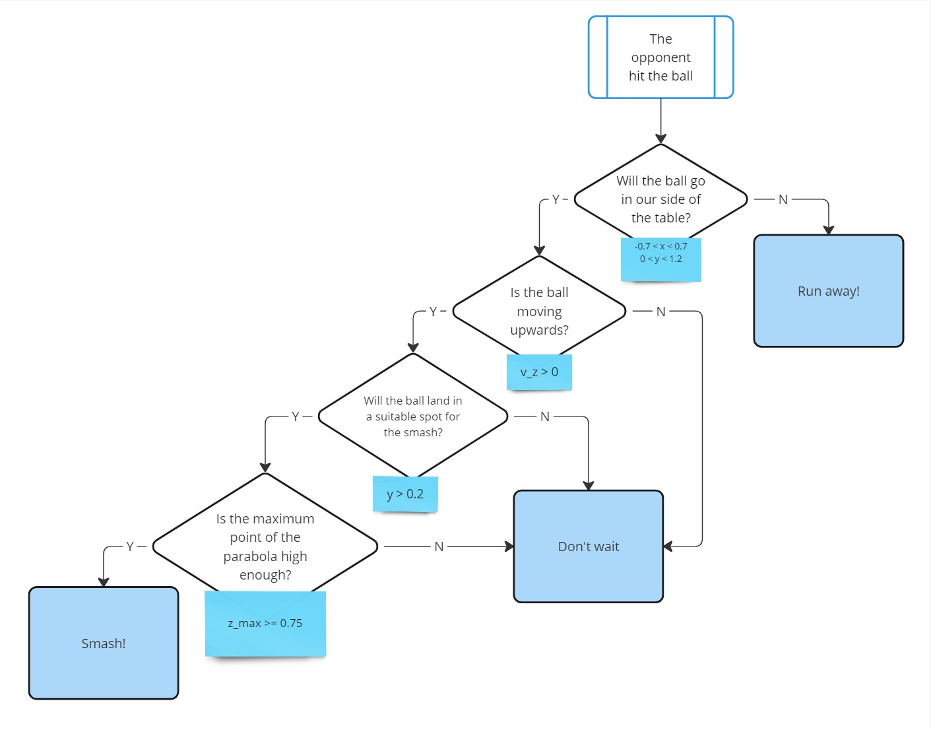
Supervised: Arm
Reinforcement: Paddles
Machine Learning – Project Work

Slide 6
Final Consideration
Reinforcement: Paddles
Machine Learning – Project Work

Slide 7
Thank you
for your attention!
Reinforcement: Paddles
Final Consideration
Machine Learning – Project Work

Slide 8
Final Consideration
Reinforcement: Paddles
Thank you
for your attention!
Machine Learning – Project Work

